Slide 1
Hebrew rhythm class
A study of rhythm class across languages

Slide 2
Focus of this study:
To investigate a previously language that has not been categorized into rhythm categories: Hebrew
To investigate whether Hebrew falls in stress-based rhythm continuum, making a comparation between English L1 L2 Hebrew with Hebrew natives and English L1 L2 Spanish with Spanish natives
To examine whether proficiency affects rythm patterns

Slide 3
Theoretical framework

Slide 4
Rhythm class
A prosodic characteristic of speech
The up and down beat of the strong and weak units of a given language (Aldrich, 2019)
Lloyd James (1940) : combination of duration, lexical stress, and melodic contour: morse-code ( English) or machine gun (French)
Pike (1945) : isochrony
stress-timed: stress- syllable equal (English)
syllable-timed: syllable equal (Spanish)
mora- timed: mora equal (Japanese)
Grabe and Low (2002) : gradient language rhythm: language rhythm may be better described as a continuum rather than purely categorical

Slide 5
Stress-rhythm languages and syllable-rhythm languages
language | syllable structure | phonological vowel reduction | acoustic correlates of stress
English | up to three consonants in the onset (straight) up to four in the coda (e.g., twelfths) (Whitley, 2002) | phonological vowel reduction in unstressed syllables (Ladefoged, 2006) | stress affects vowel duration: vowels in stressed syllables are longer than in unstressed syllables (de Jong, 2004; Van Summers, 1987)
Spanish | up to two consonants in the onset (e.g., criar) up to two in the coda (e.g., vals) (Hualde, Olarrea, escobar and Travis, 2010) | Ø (Hualde et al., 2010) | The effect is lower in Spanish (Navarro Tomás, 1917, Whitley, 2002)
Up to one consonant in the onset (e.g sefer)
Up to one in the coda, except 2 p.s suffix (katabt)
vowel reduction in Tiberian Hebrew (the canonical pronunciation of the Hebrew Bible ), but not in Modern Hebrew
vowels in stressed syllables are twice as long as vowels in stressless syllables , regardless of syllable structure (Becker, 2003)
Hebrew
Does Hebrew is more similar to stress or syllable rhythm?

Slide 6
Proficiency and L2 rhythm
if bilinguals use a unique rhythm pattern for each language or if only one rhythm pattern is used for both.
authors | Findings
Carter and Wolford (2016) | younger generation of Spanish English-bilingual living in USA exhibited a stress-rhythm pattern in their Spanish, and the reverse for older generations, who spoke Spanish with a more syllable-rhythm pattern
Does proficiency affect rhythm pattern if two languages have a similar rhythm category?

Slide 7
Rhythm measure
Authors | type of measure | Predictions: Stress-time/ syllable-time relation
Ramus, Nespor, and Mehler (1999) | 1. %V: the proportion of a given utterance that is vocalic 2. ΔV: the standard deviation of vocalic intervals 3. ΔC: the standard deviation of consonantal intervals | 1. %V: syllable-rhythm languages would have higher vowel proportions than stress-rhythm due to their general lack of vowel reduction Stress-rhythm: greater variability among vocalic intervals: high ΔV and ΔC scores Syllable-rhythm : low ΔV and ΔC scores
Vowel duration measure:
%V: equal
ΔC: different number of consonant intervals

Slide 8
The current study
The present study attempts to demonstrate phonetic similarities between Hebrew and English comparing vowel duration between:
L1 Hebrew and L1 English L2 Hebrew learners
L1 Spanish and L1 English L2 Spanish learners
It aims to examine data from L1 English who are learning an L2 language with no clear rhythm class classification –Hebrew- and to examine L1 English who are learning a well-known syllable time language, Spanish, that differ from English stress –timed.
Also the present work examines whether proficiency is a good predictor of vowel duration similarities or differences between groups.
I predict that there will be higher vowel variability between L1 English who are learning Spanish and native Spanish than and L1 English L2 Hebrew with native Hebrew
I predict that proficiency has an effect in the Spanish group vowel duration, but not in L2 Hebrew vowel duration

Slide 9
Research questions and hypotheses
RQs
Hypotheses
Does Hebrew fall in the stress-timed rhythm pattern continuum alike English?
Does proficiency modulate differences in vowel duration between L1 Spanish and L1 English L2 Spanish learners and between L1 Hebrew and L1 English L2 Hebrew learners ?
Hebrew shares vowel duration similarities of stress-timed language
Proficiency has an affect in vowel duration between L1 and L2 who belong to different rhythm class

Slide 10
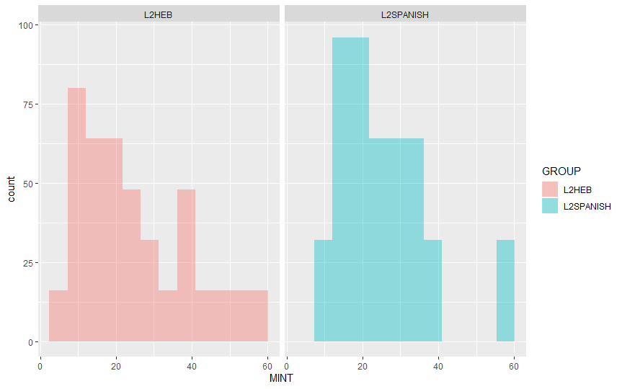
Participants
Comparison group
Experimental group
32 English Native L2 Spanish learners from Rutgers University
32 English native L2 Hebrew learners from Rutgers University and the Jewish Theological Seminary (JTS)
They have learned the target languages in an instructional context.
All of them are sequential bilinguals
32 adult Spanish-English bilingual from Universidad de Playa Ancha, Chile
32 adult Hebrew-English bilingual speakers from Tel Aviv University, Israel
They were all born and have lived in their home countries most of their lives
All of them are sequential bilinguals
no significant differences between means by group
(t = 0.32416, df = 838.82, p-value = 0.7459)

Slide 11
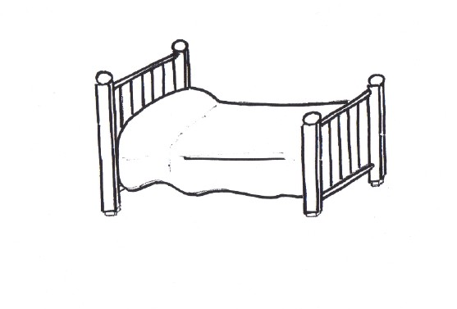

Materials
cama
Selection of 6 items from MINT for each language produced by the participants
The selection include six disyllabic items in Spanish and Hebrew
The first syllable no coda
Second syllable : Spanish no coda/ Hebrew 4 to 6 word has coda
shemesh

Slide 12
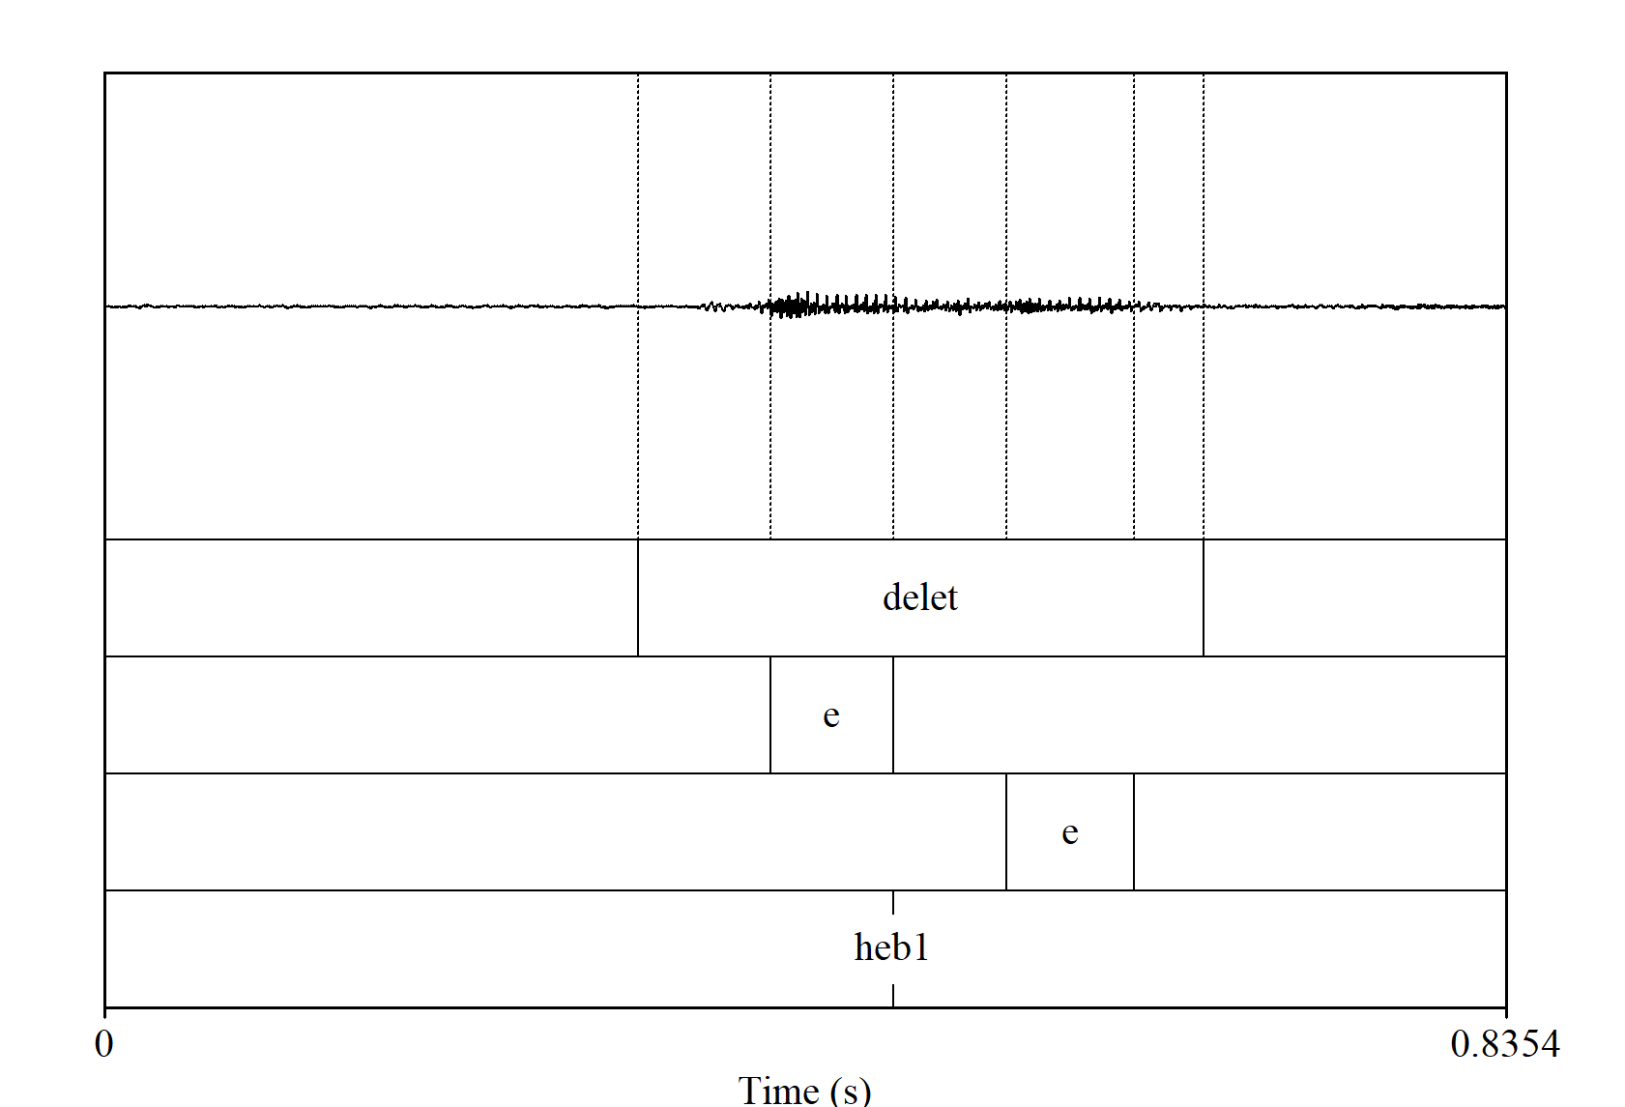
SEGMENTATION OF ACOUSTIC DATA
Segmentation in PRAAT
3 tiers:
word
vowel1
vowel2
1 point tier:
Language: HEB1-HEB2/ SP1-SP2

Slide 13
Results

Slide 14
Descriptive statistics
Vowel 1 duration
Vowel 2 duration
language | type_lan | mean_v1 | sd_v1
HEB | L1 | 0.071 | 0.026
HEB | L2 | 0.073 | 0.029
SPAN | L1 | 0.063 | 0.019
SPAN | L2 | 0.079 | 0.020
language | type_lan | mean_v2 | sd_v2
HEB | L1 | 0.083 | 0.037
HEB | L2 | 0.092 | 0.036
SPAN | L1 | 0.058 | 0.021
SPAN | L2 | 0.091 | 0.031
Higher vowel variability in L1 HEB than L1 SPAN
Higher mean differences between L1-L2 SPAN than L1- L2 HEB

Slide 15
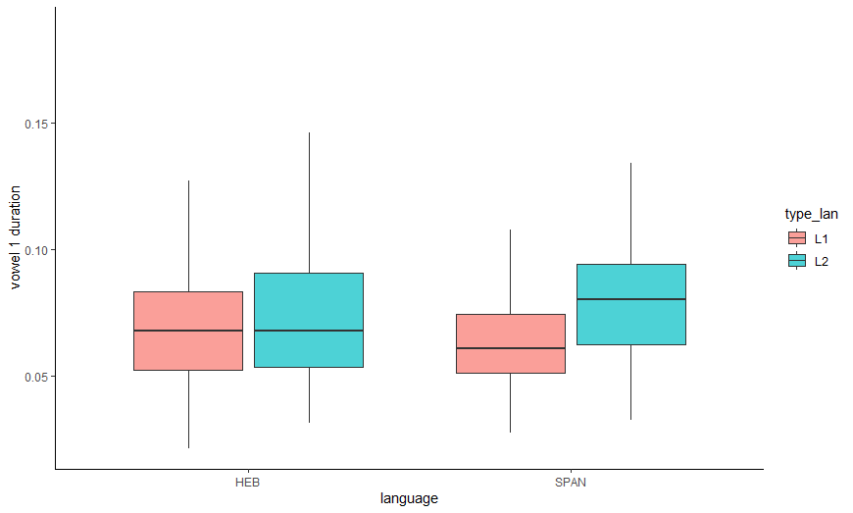
Vowel 1 by type of language
Linear model 1 and 2
Vowel | Language | Significance
Vowel 1 | Hebrew | p > 0.05
vowel 1 | Spanish | p < 0.01

Slide 16
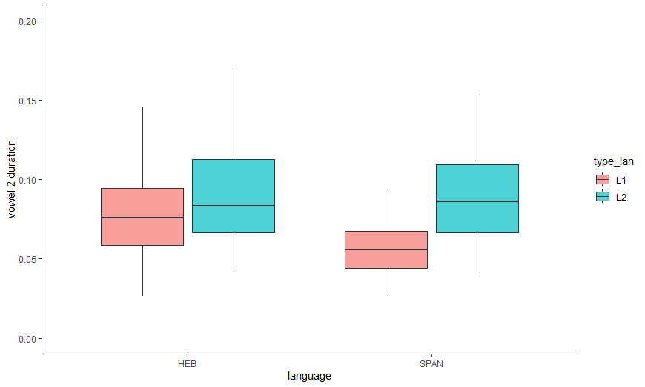
Vowel 2 by type of language
Linear model 3 and 4
Vowel | Language | Significance
Vowel 2 | Hebrew | p = 0.05
vowel 2 | Spanish | p < 0.01

Slide 17
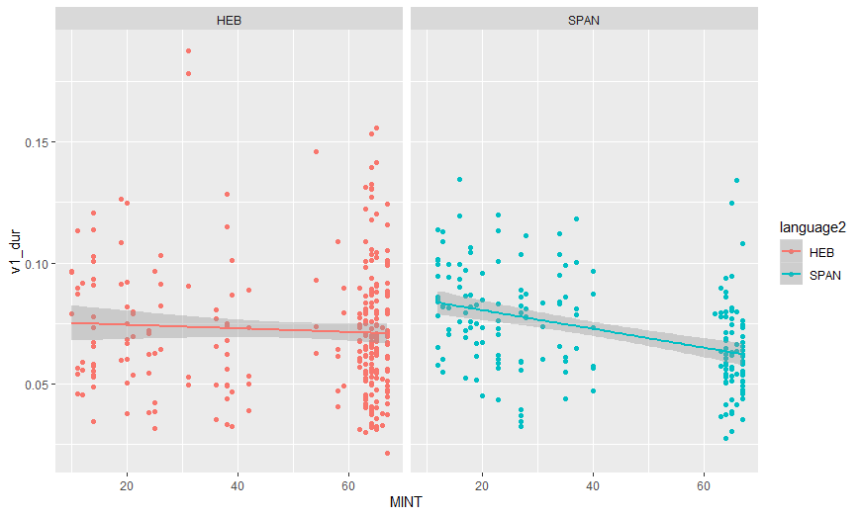
Vowel 1 by proficiency (MINT)
Linear model 5 and 6
Vowel 1 by MINT | Language | Significance
Vowel 1 | Hebrew | p = 0.365
vowel 1 | Spanish | p < 0.01

Slide 18
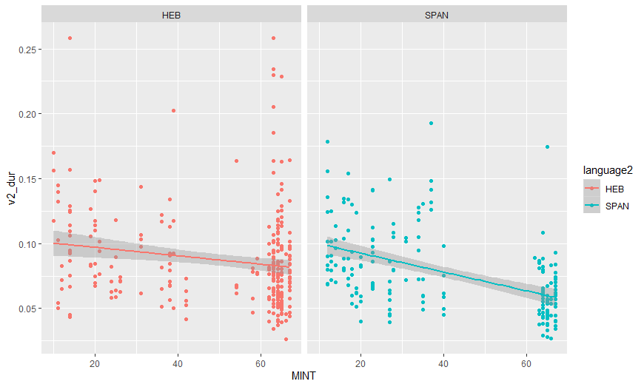
Vowel 2 by proficiency (MINT)
Linear model 7 and 8
Vowel 2 by MINT | Language | Significance
Vowel 2 | Hebrew | p = 0.03
vowel 2 | Spanish | p < 0.01

Slide 19
Discussion

Slide 20
Hypothesis 1:
Hebrew shares vowel duration similarities of stress-timed language
Results | Previous studies
L1 English L2 Hebrew showed lower variability in vowel duration compared with native Hebrew than L1 English L2 Spanish compared with native Spanish | Becker (2003): Hebrew intonation. Location of high tones in Hebrew should be understood as a realization of metrical structure, namely trochaic feet. Niebuhr (2012): stress-timed languages are closer to a trochaic feet: stressed syllable followed by unstressed syllable

Slide 21
Hypothesis 2
Proficiency has an affect in vowel duration between L1 and L2 who belong to different rhythm class
Results | Previous studies
Mint results has a significant effect in the Spanish group in vowel1 and vowel2 duration Mint has no effect in Hebrew group in vowel 1 duration, but has an effect in Hebrew vowel 2 duration, but the effect is not so strong compared to vowel 2 duration in the Spanish group. | - Carter and Wolford (2016): younger generation of Spanish speaker (lower Spanish proficiency) exhibited a stress-rhythm pattern in their Spanish and older generations spoked Spanish with a more syllable-rhythm pattern (higher Spanish proficiency)

Slide 22
Conclusions
Hebrew share more prosodic features with English than Spanish
This suggest that Hebrew falls in the stress-timed continuum rather than the syllable-timed continuum
Proficiency is a not a good predictor of rhythm in bilingual speakers if bilinguals has two languages with similar prosodic features
Rhythm can be acquired by bilinguals that speak an L1 that has different rhythm features than the target language

Slide 23
thanks muchas gracias תודה רבה

